Slide 1
EGT307 EnviroSense
BY: BACON.Inc
WEI GUAN
SHUN WEI
DEREK

Slide 2

Problem Statement
Current environmental monitoring systems rely on manual analysis of sensor data, which is inefficient and prone to delayed responses.

Slide 3

Relevance to the real world
In a nuclear plant, catching a sudden change in air quality is a race against an invisible hazard.
Human operators get tired and miss things.
By using AI, the plant can predict emergencies instead of just reacting to them.

Slide 4

objectives
Automated Analysis: Use machine learning to interpret sensor data instead of relying solely on raw readings
Early Detection: Identify abnormal environmental conditions (e.g., pollution spikes, temperature anomalies) before they escalate.

Slide 5

Intended benefits
Reduced Manual Monitoring: AI automatically monitors environmental data, reducing the need for constant human supervision.
Early Hazard Detection: Provides timely alerts to help prevent or minimise environmental risks.
Improved Accuracy: AI detects abnormal patterns that may be missed during manual monitoring.
Scalable and Easy to Maintain: The microservices architecture allows each service to be updated, maintained, and scaled independently.

Slide 6

Data sources
Data is collected through sensors that is placed in a controlled environment. The controlled environment is meant to simulate work conditions in a dangerous environment such has a chemical or nuclear powerplants. The following features of the data are Temperature, Humidity and Air Quality.

Slide 7
Diagram
IoT Sensors
Data Ingestion
Database
Prediction
MACHINE LEARNING
Backend API
Notification
Telegram Bot
FRONTEND DASHBOARD

Slide 8

Sensor architecture
The Sensor Architecture is responsible for simulating IoT sensors by continuously reading environmental data from the CSV dataset. It loops through the existing dataset and sends one record at a time to the Data Ingestion Service through REST API requests. This simulates a real-time data stream, allowing the rest of the system to process, analyse, and display sensor data as if it were coming from actual IoT devices.
This Photo by Unknown Author is licensed under CC BY-SA

Slide 9
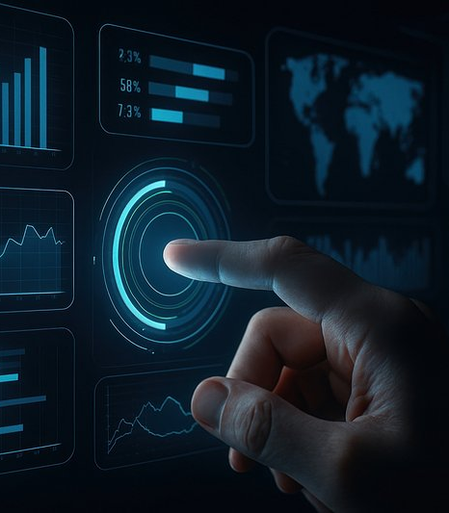
DATA INGESTION
The Data Ingestion Service collects real-time sensor data, such as temperature, humidity, CO₂, and air quality, from IoT sensors. It validates the data, stores it in the database, and sends it to the Machine Learning Service for analysis. Separating this function into its own microservice makes the system easier to scale, maintain, and expand.

Slide 10
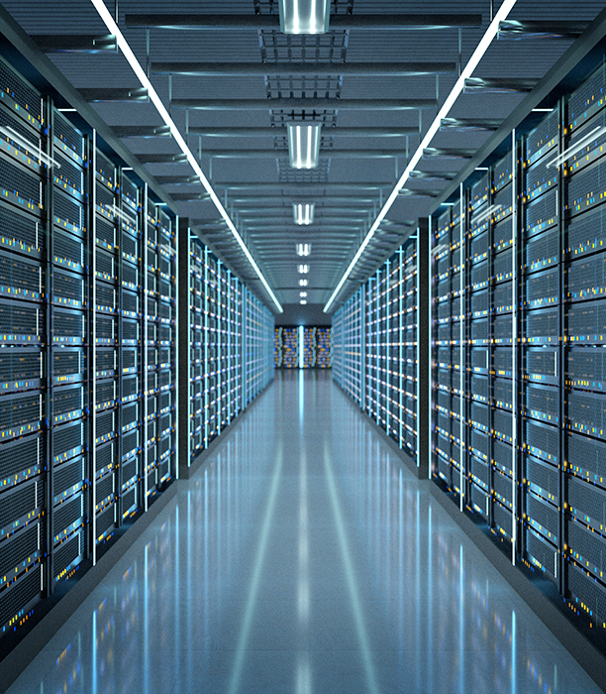
DATABASE
The Database Service stores the imported environmental monitoring dataset, anomaly prediction results, and historical records. The Backend API retrieves data from the database for preprocessing and machine learning analysis, while prediction results are stored for future reference and visualisation. This provides persistent and centralized data storage, enabling efficient data management and historical analysis.
This Photo by Unknown Author is licensed under CC BY-SA

Slide 11

BACKEND API
The Backend API Service acts as the communication layer between all microservices. It receives requests from the Frontend Dashboard, retrieves sensor data from the database, sends data to the Machine Learning Service for prediction, stores the prediction results, and returns the processed information to the user.

Slide 12
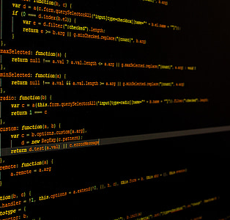
MACHINE LEARNING
The Machine Learning Service receives validated sensor data from the Backend API, analyses it using the trained model, and returns prediction results. If an abnormal condition is detected, the Backend API stores the result in the database and triggers the Notification Service to send a Telegram alert.

Slide 13

NOTIFICATION SERVICE
The Notification Service monitors the AI prediction results and checks for abnormal environmental conditions. When a sensor reading exceeds the predefined threshold, it automatically sends an alert to users through a Telegram bot. This allows users to receive instant notifications on their phones and respond quickly. As a separate microservice, it is also easy to maintain, update, and scale independently.
This Photo by Unknown Author is licensed under CC BY-ND

Slide 14
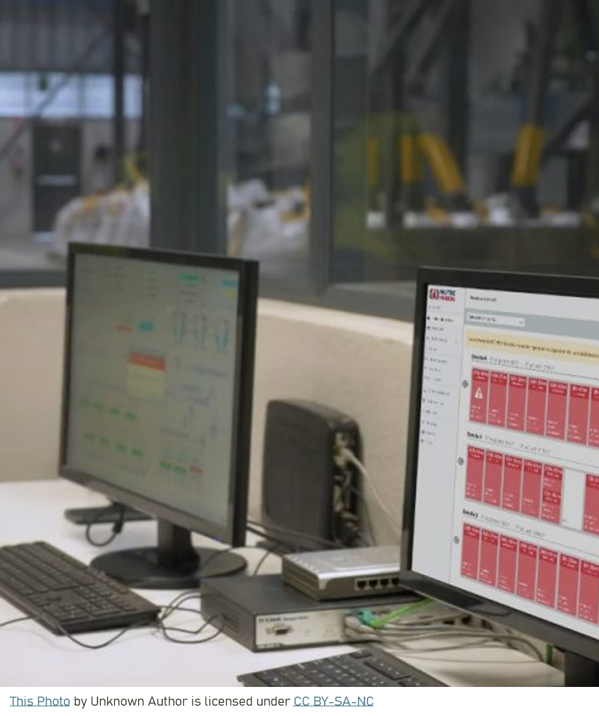

FRONTEND DASHBOARD
The Frontend Dashboard provides a user-friendly interface for monitoring environmental conditions. It displays sensor data, anomaly detection results, and historical trends by sending REST API requests to the Backend API. Users can easily view environmental status and receive alerts without directly interacting with the database.

Slide 15

DOCKER
Each application component is packaged as a Docker container to provide a lightweight, portable, and consistent runtime environment across development, testing, and production. Docker eliminates dependency conflicts and ensures that the application behaves consistently regardless of the deployment platform.
This Photo by Unknown Author is licensed under CC BY-SA-NC

Slide 16

KUBERNATES
The containers are orchestrated using Kubernetes, which automates deployment, scaling, load balancing, and recovery of application services. Kubernetes continuously monitors the desired state of the system and automatically replaces failed Pods, ensuring high availability and fault tolerance. The orchestration platform also enables the application to scale horizontally by creating additional Pods when system workload increases.
This Photo by Unknown Author is licensed under CC BY-NC-ND

Slide 17

ISSUES AND LIMITATIONS
Limited Dataset and Simulation: The system uses a limited, static CSV dataset to simulate IoT sensors, so it may not fully represent real-world sensor behaviour or how the ML model performs on new data.
Alert Threshold: The “anomaly_score_threshold” is a design choice. A threshold that is too low may cause too many false alerts, while one that is too high may cause genuine anomalies to be missed.

Slide 18
THANK YOU

